Slide 1
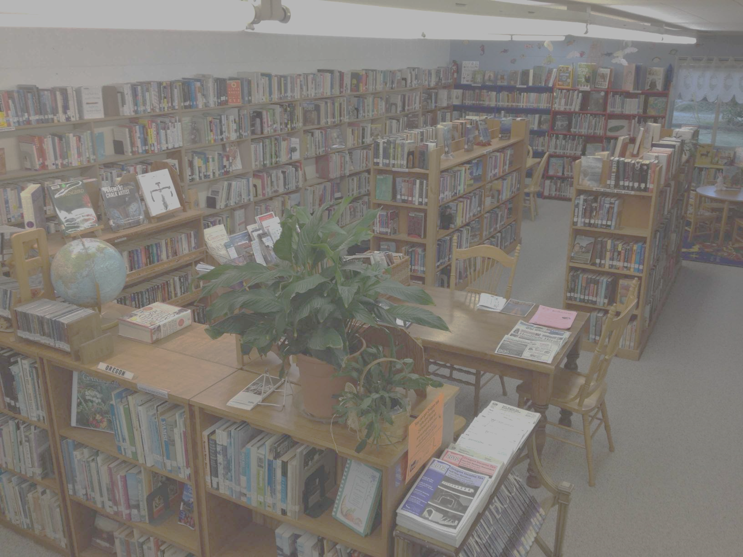
THE CITY LIBRARY
CS 631
DATABASE MANAGEMENT SYSTEM
DELIVERABLE 3
Project by:
Sahaj Singh Marwah (ssm226@njit.edu)
Chintan Modi(cvm6@njit.edu)
Charanpreet Kaur Dhir(ckd22@njit.edu)
Under Professor :
Dimitri Theodoratos
(dth@njit.edu)

Slide 2
a. Goal for this phase of the project
To develop a menu driven application system for the public library system database.
Run SQL commands for creating tables including primary keys, secondary keys and foreign keys. Run SQL command files that populate each table.

Slide 3
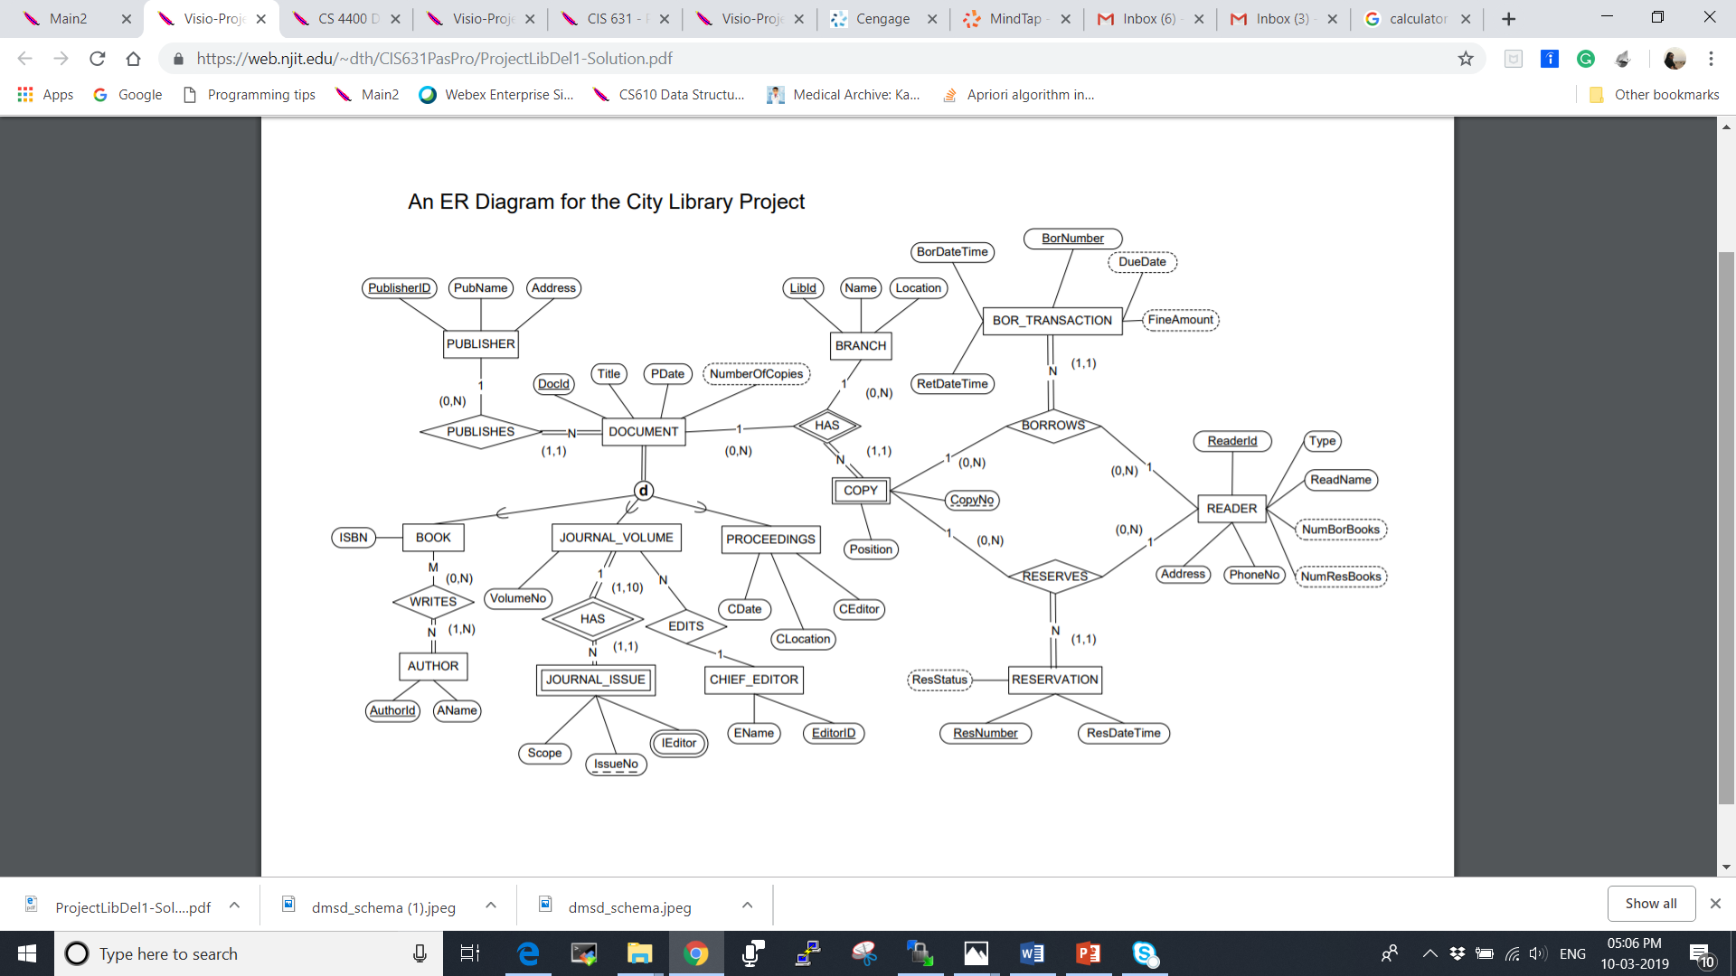
ER DIAGRAM

Slide 4
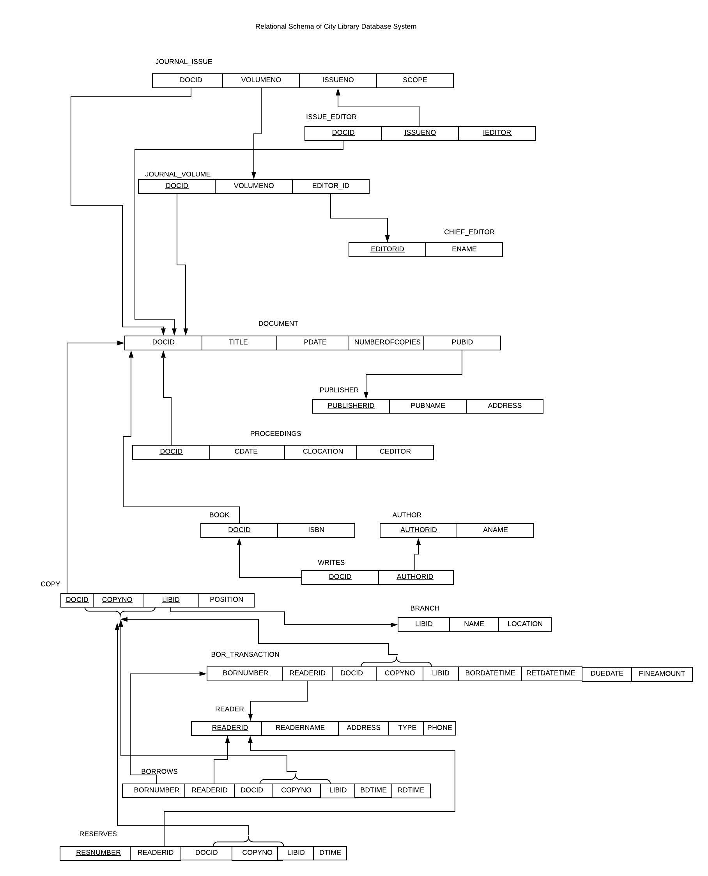

Slide 5
Primary Keys and Foreign Keys identified in Relational schema Primary Keys are: - DocID, VolumeNo and IssueNo in JOURNAL_ISSUE entity - DocID, IEDITOR and IssueNo in ISSUE_EDITOR entity - VolumeNo in JOURNAL_VOLUME entity - EditorID in CHIED_EDITOR entity - DocID in Document entity - DocID in PROCEEDINGS entity - PublisherID in Publisher entity - DocID in BOOK entity - DocID and AUTHORID in WRITES entity - AUTHORID in AUTHOR entity - LIBID in BRANCH entity - RESNUMBER in RESERVES entity - DOCID, LIBID and COPYNO in COPY entity - BORNumber in BORROWS entity - BORNumber in BOR_TRANSACTION entity

Slide 6
Description of Implementation: City Library Management Application is the menu driven application for library user and workers to manage the books, documents and journals to make it easier for the librarian and the reader. This makes easier for the admin and user to manage the library function from one application. They can perform all essential functions from this app. This software has following menu’s: - Main Menu - Reader Function Menu - Administrative Function Menu

Slide 7
Technologies Used :
Java
Java Swing
JDBC
MySQL
Software Used: To run the Application, we used :
- Eclipse IDE (version: 4.11.0) and
- MYSQL Workbench (6.3.10)
- OS Windows 10
To run application: 1. Run src/main/resources/db/create.sql 2. Run src/main/resources/db/data.sql 3. Run MainWindow.java

Slide 8
Functions the software support:
Main Menu: Reader functions (ask for card number, and then show sub-menu). Administrative Functions (ask for ID and password, and then show submenu). Reader Function Menu:
Search a document by ID, title, or publisher name. Document checkout. Document return. Document reserve. Compute fine for a document copy borrowed by a reader based on the current date. Print the list of documents reserved by a reader and their status. Print the document id and document titles of documents published by a publisher. Administrative Function Menu:
Add a document copy. Search document copy and check its status. Add new reader. Print branch information (name and location). Print top 10 most frequent borrowers in a branch and the number of books each has borrowed. Print top 10 most borrowed books in a branch. Print the 10 most popular books of the year. Find the average fine paid per reader. Quit.

Slide 9
3. Problem Faced:
1) Difficulties faced in Java part were mainly related to work on logical part according to needed features to be implemented.
2) Difficulties faced in database part were populating the data in table for the reason that we had already implemented referential integrity constraints. To resolve this we used approach suggested by Professor in Class.
3) While testing thoroughly for bugs, we faced bit problems to go through all the possible failed cases and resolve those.

